Slide 1
Crusade! Game Pitch for CSCE 4210/5250 Fall 2015
Group 7

Slide 2
Programmers
CSCE 4210.003
Dalton Barrett
Zachary Corley
Tanner Van De Walle

Slide 3
General
RPG Platformer
The goal is for the PC to reach the end of the level.
Levels separate the gameplay.
There is a finite number of levels that follow the PC on his/her quest for the Holy grail.
NPCs or monsters spawn at start and provide challenge in reaching the goal.

Slide 4
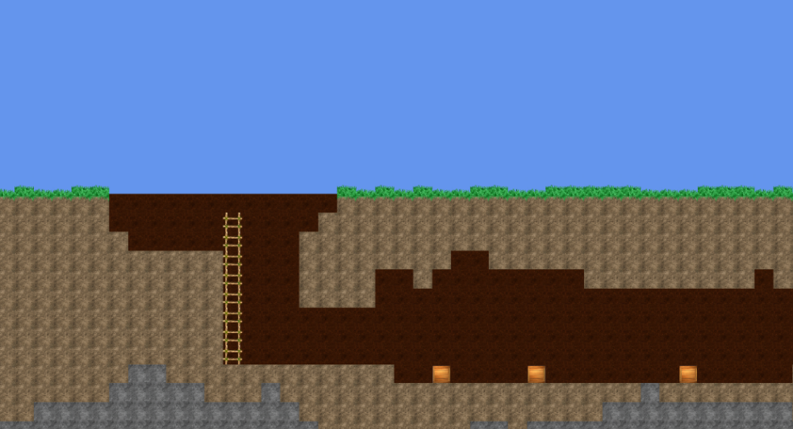
The World
Consists of a backdrop with a destructible tile based environment.
The world follows simple physics.
Each level has a finite width and height that the PC scrolls through as they move.
Backdrop with parallax scrolling

Slide 5
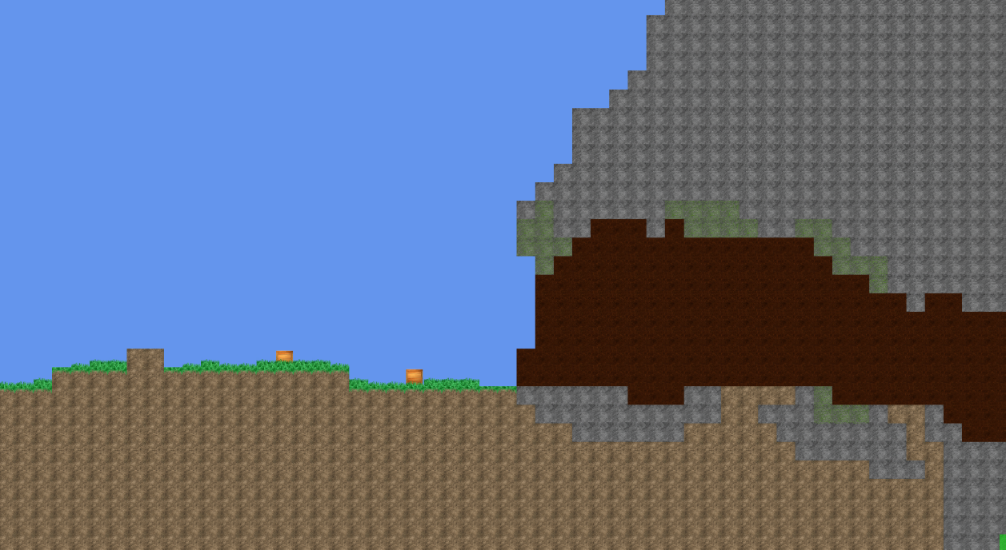
Camera
Orthographic camera
Follows the general location of the PC based off of a bounding box
Shakes on certain skills.

Slide 6
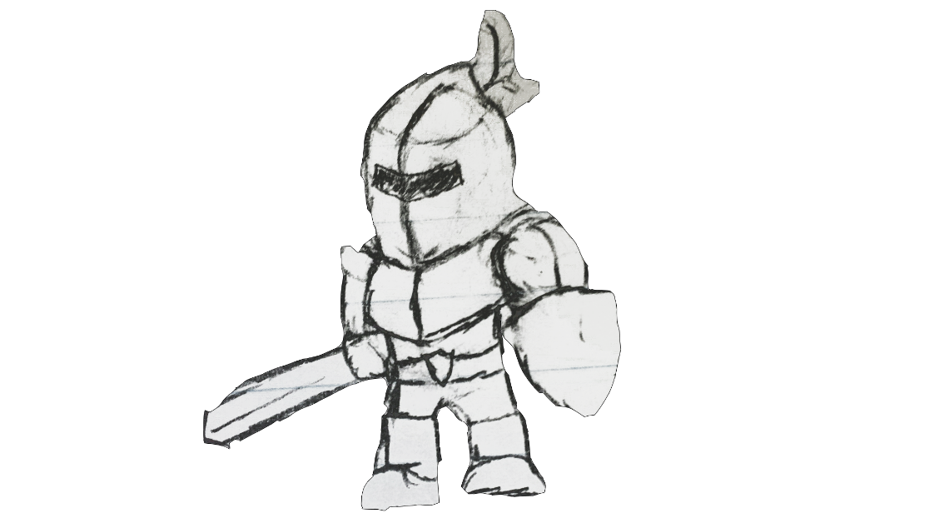
Player Character (PC)
A knight of the Crusade
Moved by the player through the environment.
Learns skills throughout the game via skill system to assist in completing the goal, and destroying everything.
Has heath, mana and damage multiplier that scales with level.
Once health reaches zero player is dead and must restart level from beginning.

Slide 7



Skill System
PC has four slots to assign skills to.
Learns many differing skills on leveling up.
Gains ability to modify skills with variations of those skills.

Slide 8
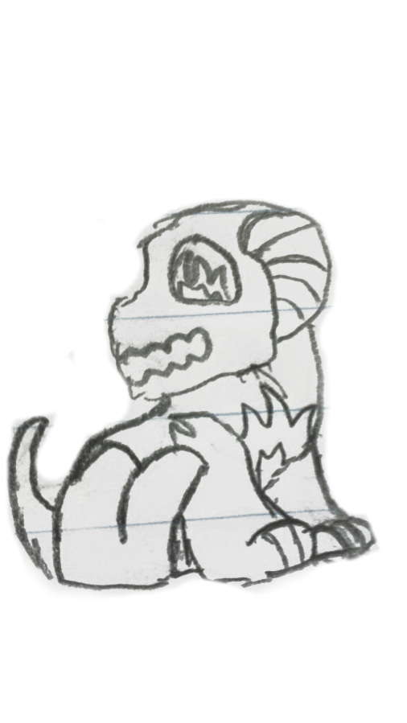
Non Player Character (NPC)
Assortment of fantasy creatures with a wide array of skills and health to challenge the PC
Use basic raycasting to determine whether to attack or idle
Takes varying damage from skills and dies when its health drops to zero
Once health drops to zero NPC initiates death animation.
Provides experience to PC on death.

Slide 9
User Interface
Keyboard commands control of the PC
User can change key bindings
Health bar and mana bar displayed in corner with skill bar.
Simple pause menu
Between level menu for level selection and skill selection.

